Slide 1
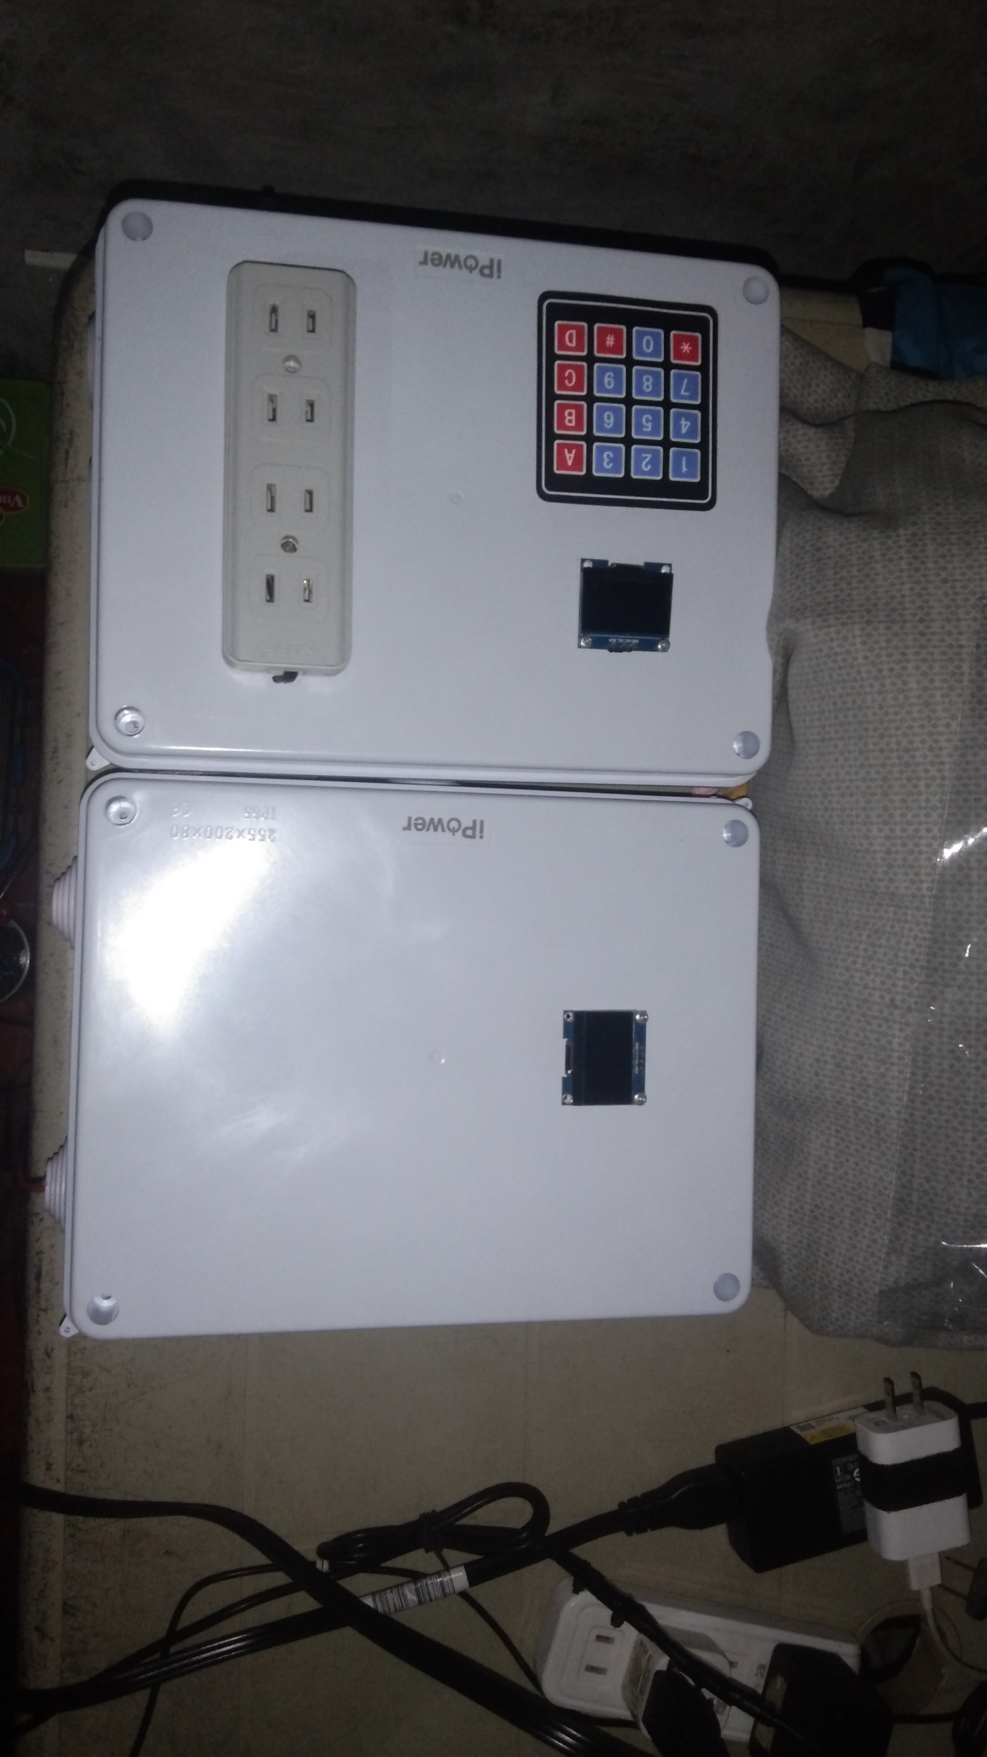

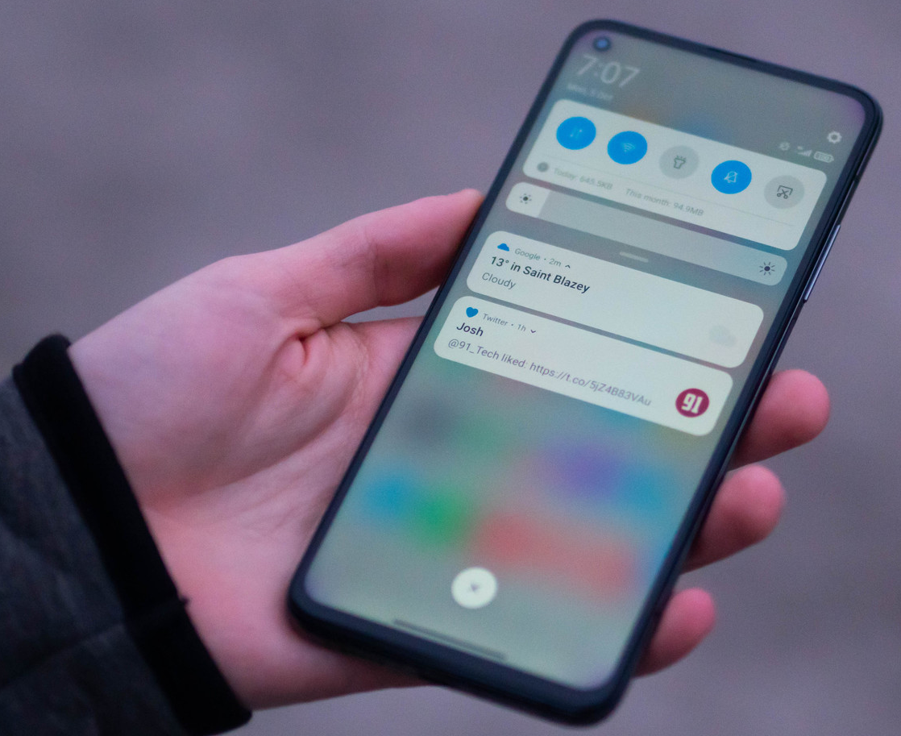
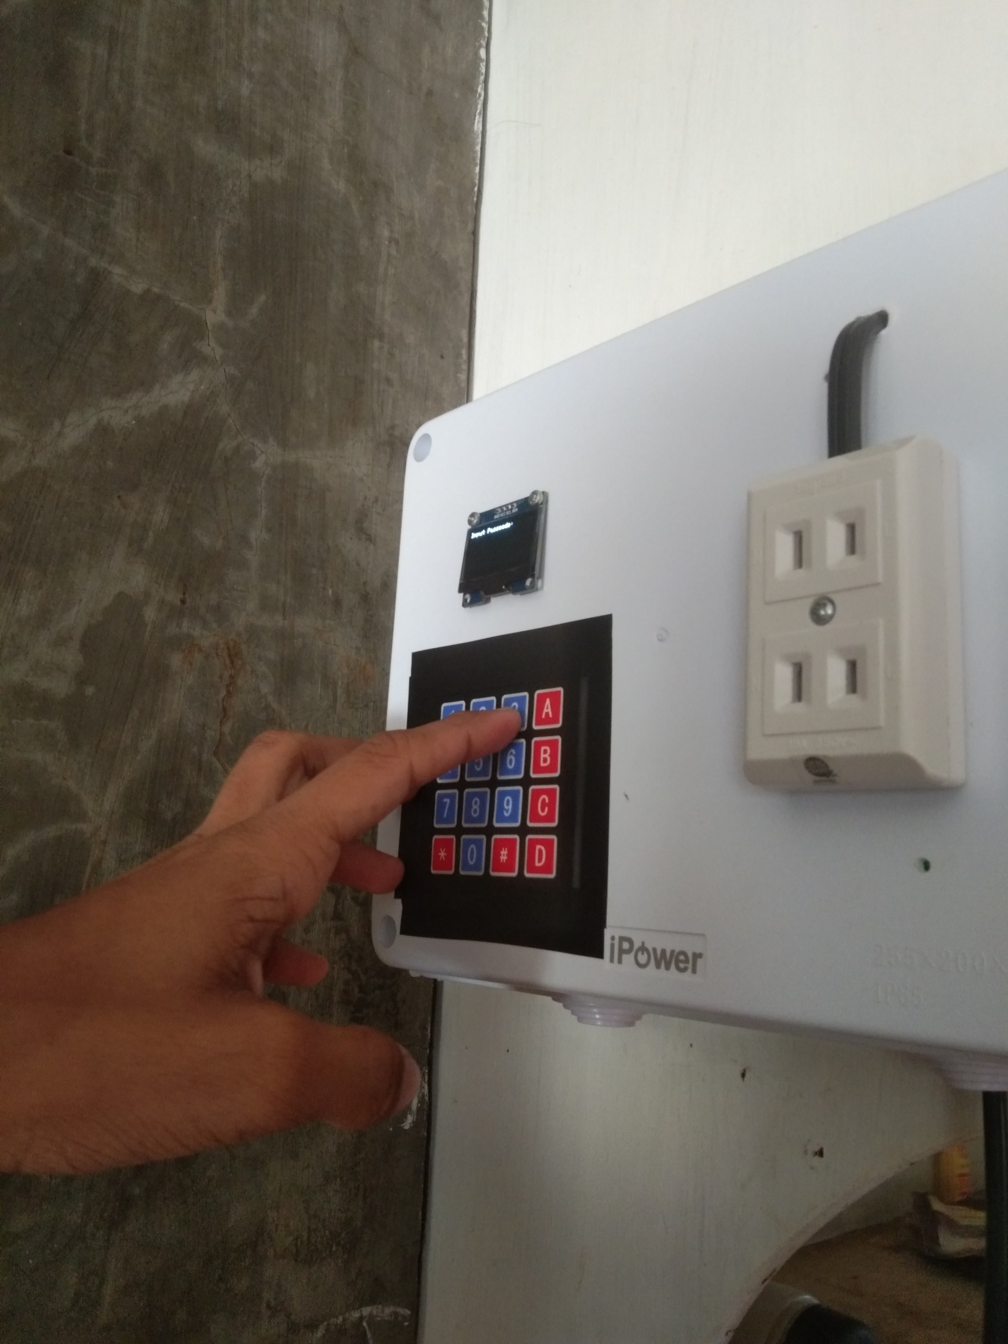
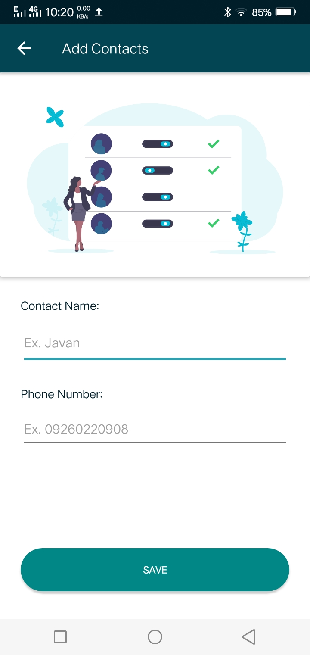
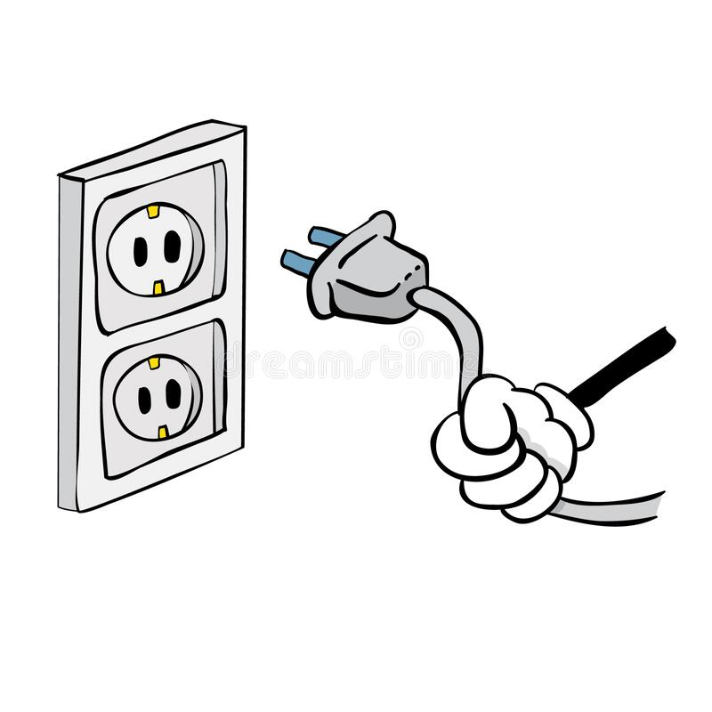

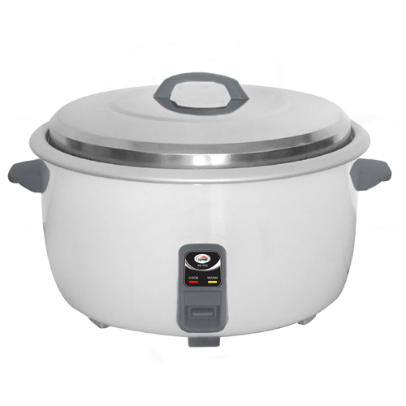
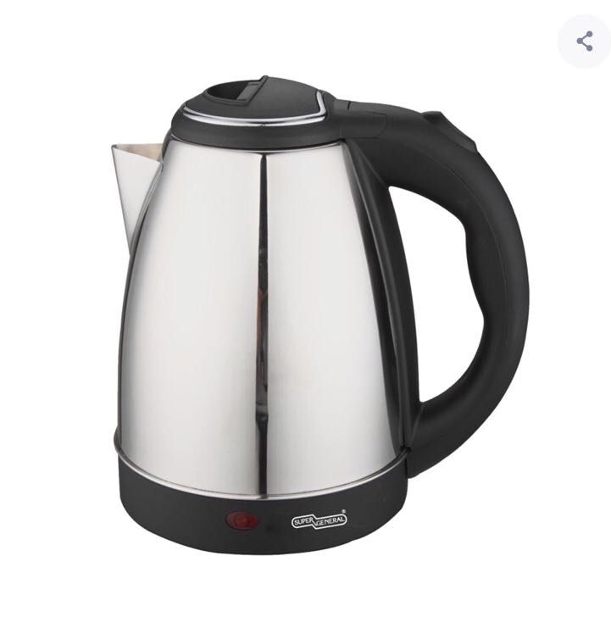
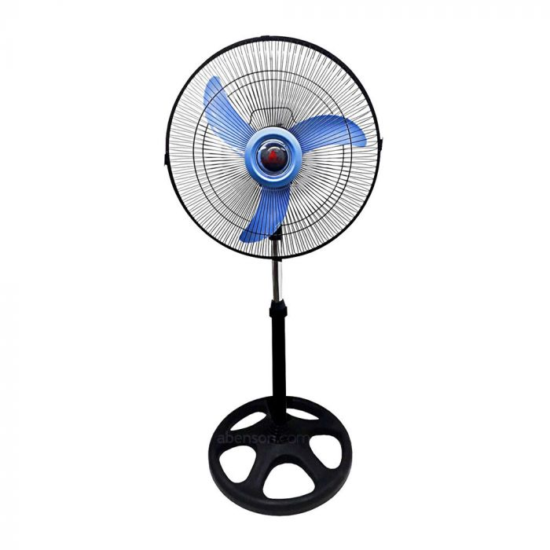
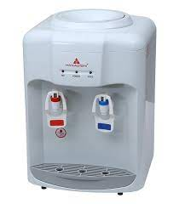
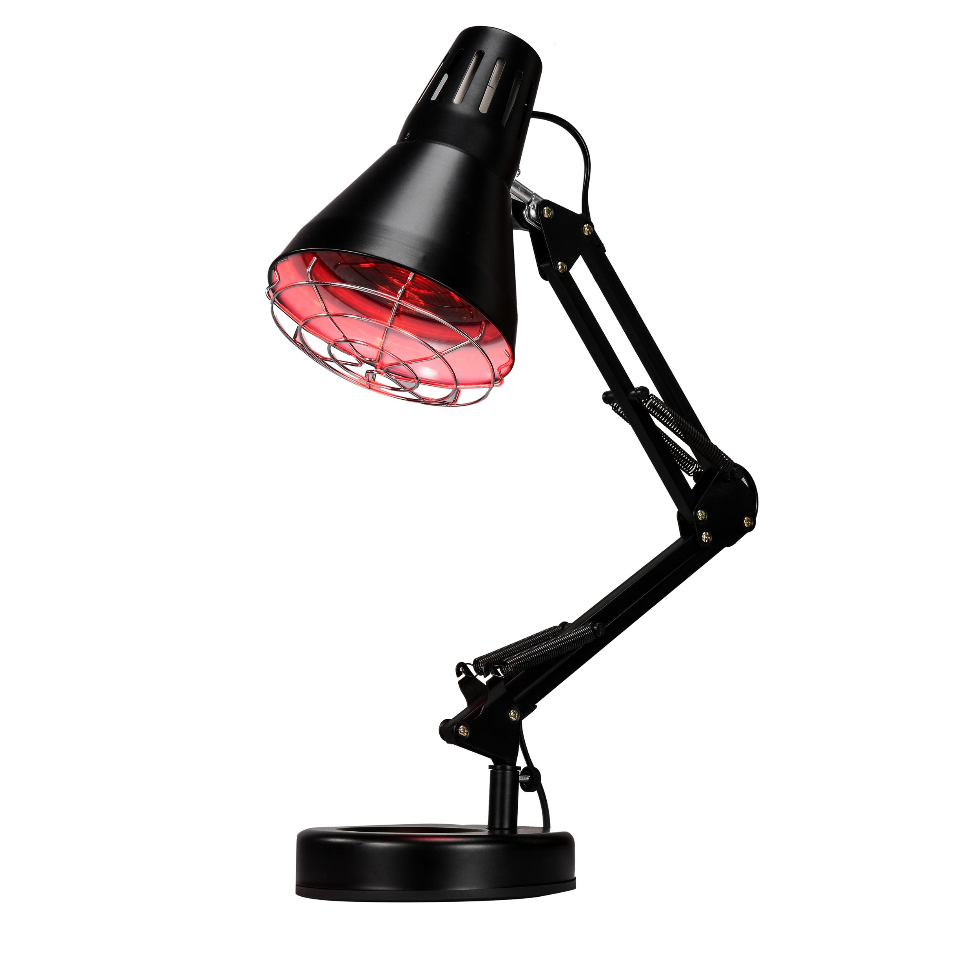

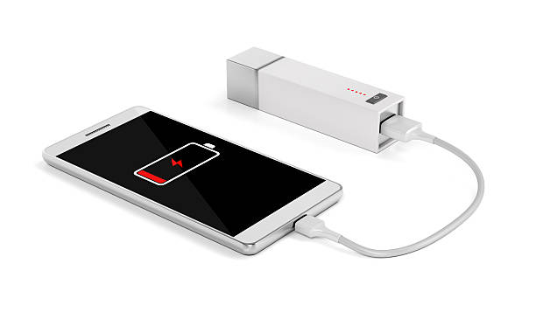
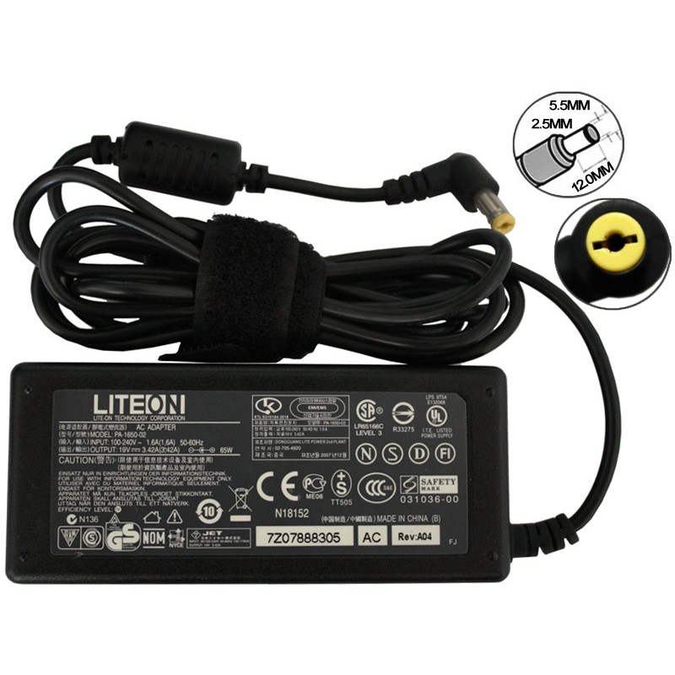
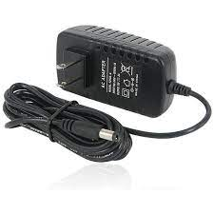

Individualized Electric Energy Monitoring System
Instructions & User manual for Data Gathering
A
B
Steps:
1. Register as a user using the Android application for the system. Ask for the assistance of the administrative personnel.
In accessing electric energy through the meter unit:
1. Enter your unique passcode, that was given to you after being registered as a new user, on the meter unit by pressing the keypad on the device.
The inputted values are shown on the OLED display.
2. Provide your full name and your active contact number when registering as a new user.
A passcode will be generated by the application upon finishing the registration process.
Use the generated passcode to access electricity on the meter unit. Remember not to share your passcode so it will not be used without your consent.
2. If you wish to clear your input, press the “B” key on the keypad.
Press the “A” key to validate your passcode and access electricity.
If you want to stop using the device, just unplug it from the meter. The meter will detect if there is any load connected and turn off if there is no device/load in the circuit.
Electrical Appliances that are allowed to be used with the system:
Participation and Consent Form
Rice cooker
Water heater
Electric Fan
You are being invited to participate in a protype testing of the thesis study titled "Individualized Electric Energy Consumption Monitoring." This study is being done by students from the Department of Computer Engineering at Southern Leyte State University—Main Campus.
The purpose of this research study is to test and observe the deployment of the developed system prototype in its target environment.
The prior usage of the prototype system is shown and organized above. All the data gathered during the time of deployment is going to be used solely for the purpose of completing the study and nothing more. Respondents will be briefed on the proper usage of the system and safety measures. Any actions being taken that violate the researcher's warnings are outside the scope of the researcher’s responsibility.
If you agree to the terms and participate in the study, please fill in the form below:
I agree to the terms and conditions.
Full Name:______________________________________________
Role:__________________________________________________
(ex. Study respondent, Boarding house owner/operator)
Electric Water Dispenser
Desk Lamp
Cellphone Charger
Laptop Charger
Wifi Power Adapter (12V adapter)

